Slide 1
Algorithmic Accountability Reporting
JOUR479V/779V – Computational Journalism
University of Maryland, College Park
Nick Diakopoulos, Ph.D.

Slide 2
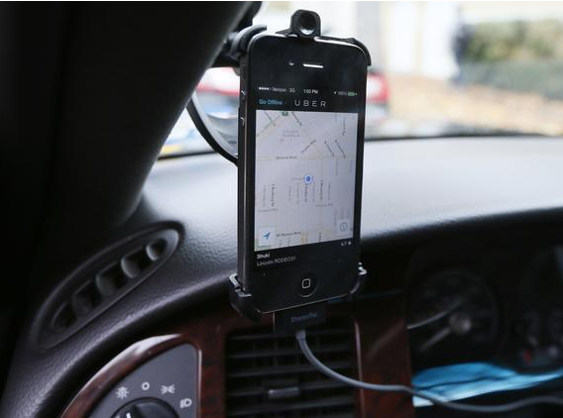
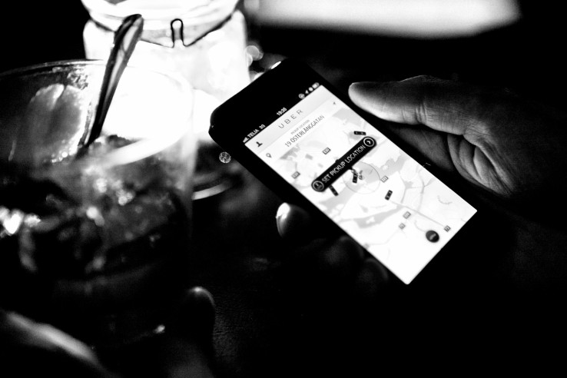
Notes:
Describe the service and how it works, discuss some of the advantages: better prices, more supply, more convenience for users, and disadvantages: sidesteps some regulation (lawsuit over blind passengers), makes it hard for drivers to negotiate b/c they are indep contractors.
Very apro po to talk about Uber in France where it’s very controversial.

Slide 3
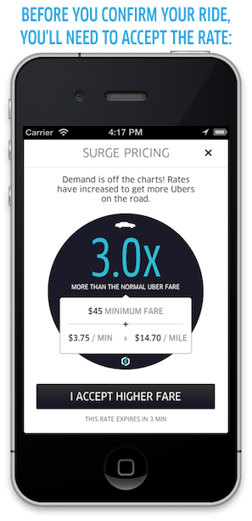
Notes:
Talk about surge prices, and how they are algorithmically dictated. The algorithm tries to manipulate the price to stimulate more drivers to come out as well as to control the demand for the product.
Broaden out to other peer sharing platforms: things like Airbnb also use algorithms: it’s about trying to optimally match buyers and sellers in an algorithmically mediated market. The problem is that we have no idea how those algorithmsm are working.

Slide 4
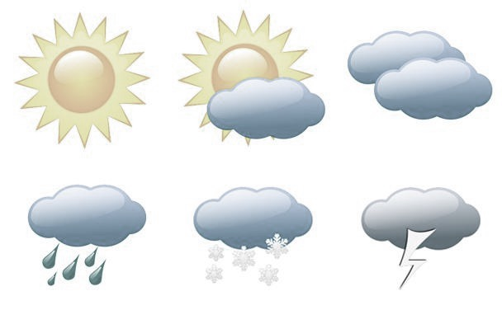
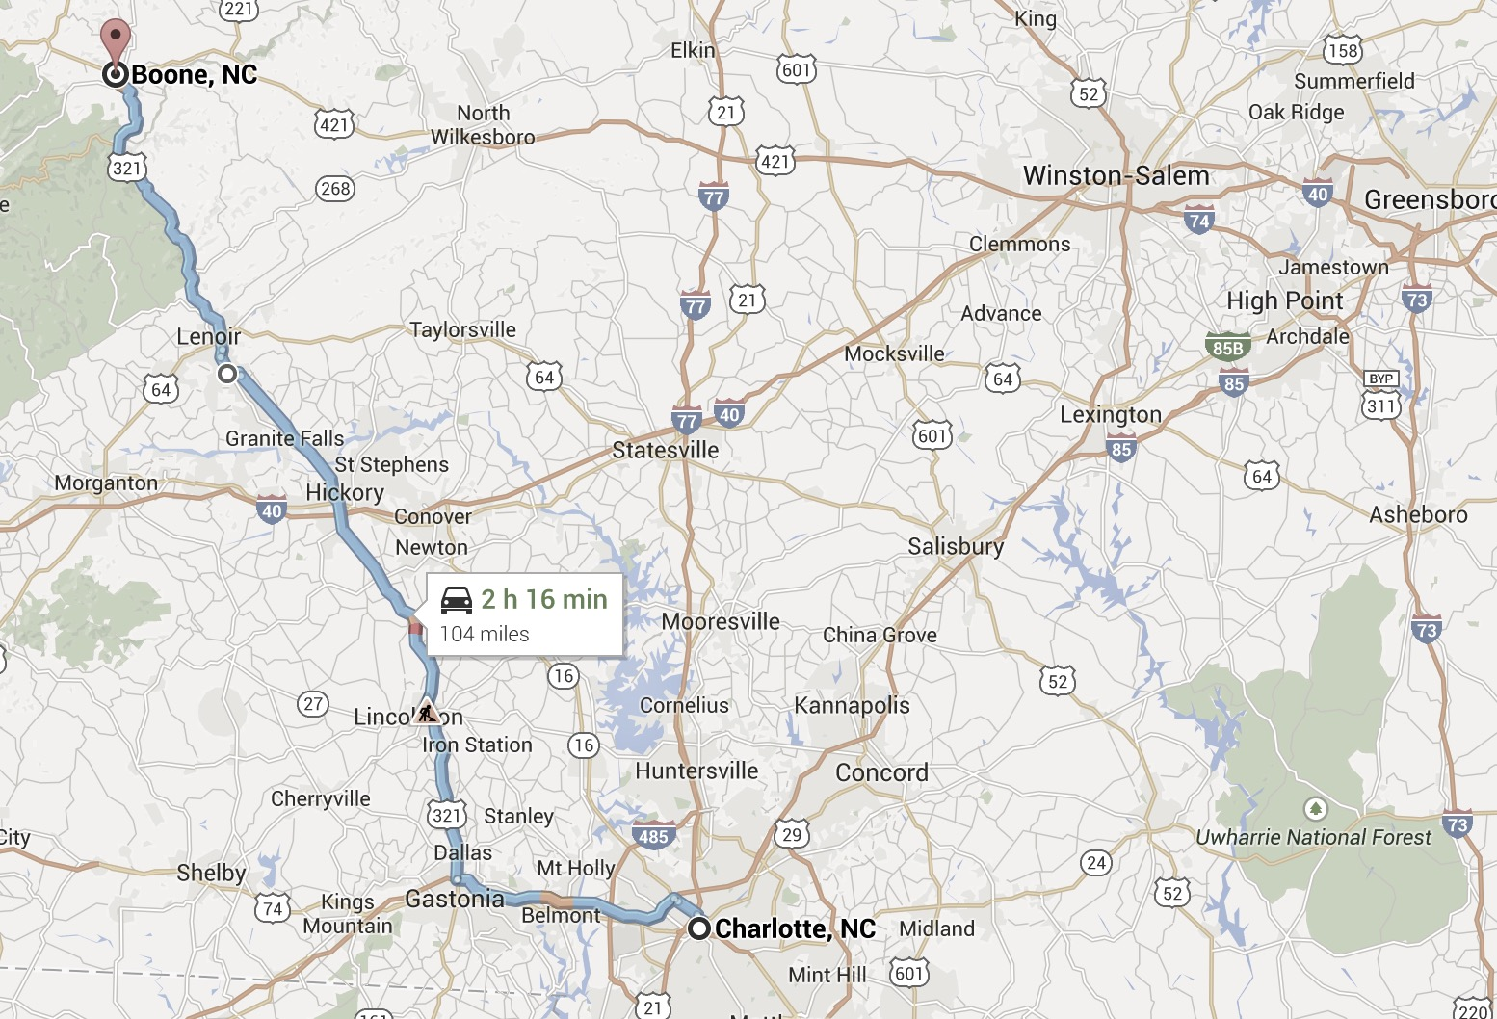



Do surge prices even work? If so, how?
Notes:
Why does this investigation matter? We want to know about potential price discrimination that the algorithm might facilitate. We want to know whether some neighborhoods have better service than others, and if there are correlations to socio economics.
The worry is that the worst served neighborhoods have the least supply of uber vehicles, which might lead to higher surge prices and an deleterious feedback loop which drives prices even higher in those neighborhoods.
What do surge prices depend on?
Weather?
Location?
Supply?
Length of trip?
User profile or history?
Other factors?
Do surge prices even work to get more supply?
How can we investigate this algorithm?

Slide 5
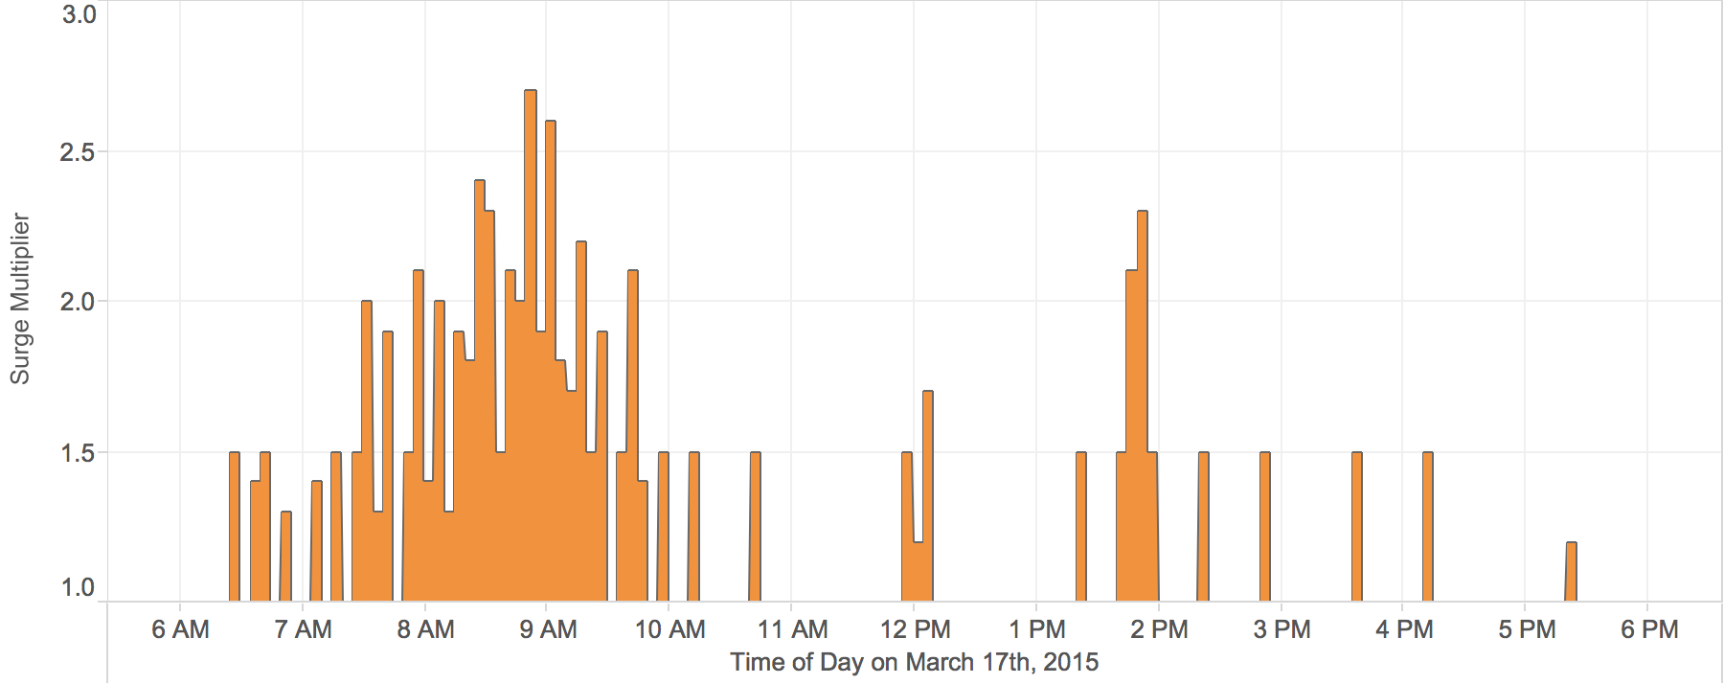
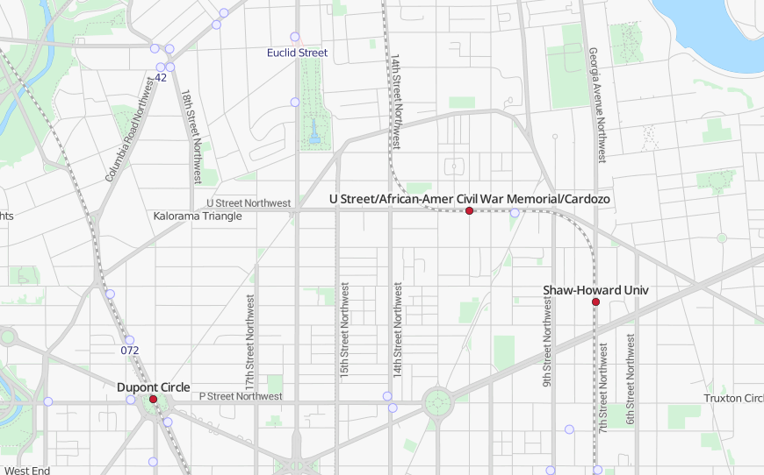
Notes:
So back to the original question of whether uber surge pricing actually works.
I collected 4 weeks worth of data from Ubers own api and started asking questions, like how often does the price actually change? You can see neighborhood level patterns, as well as spikes.

Slide 6
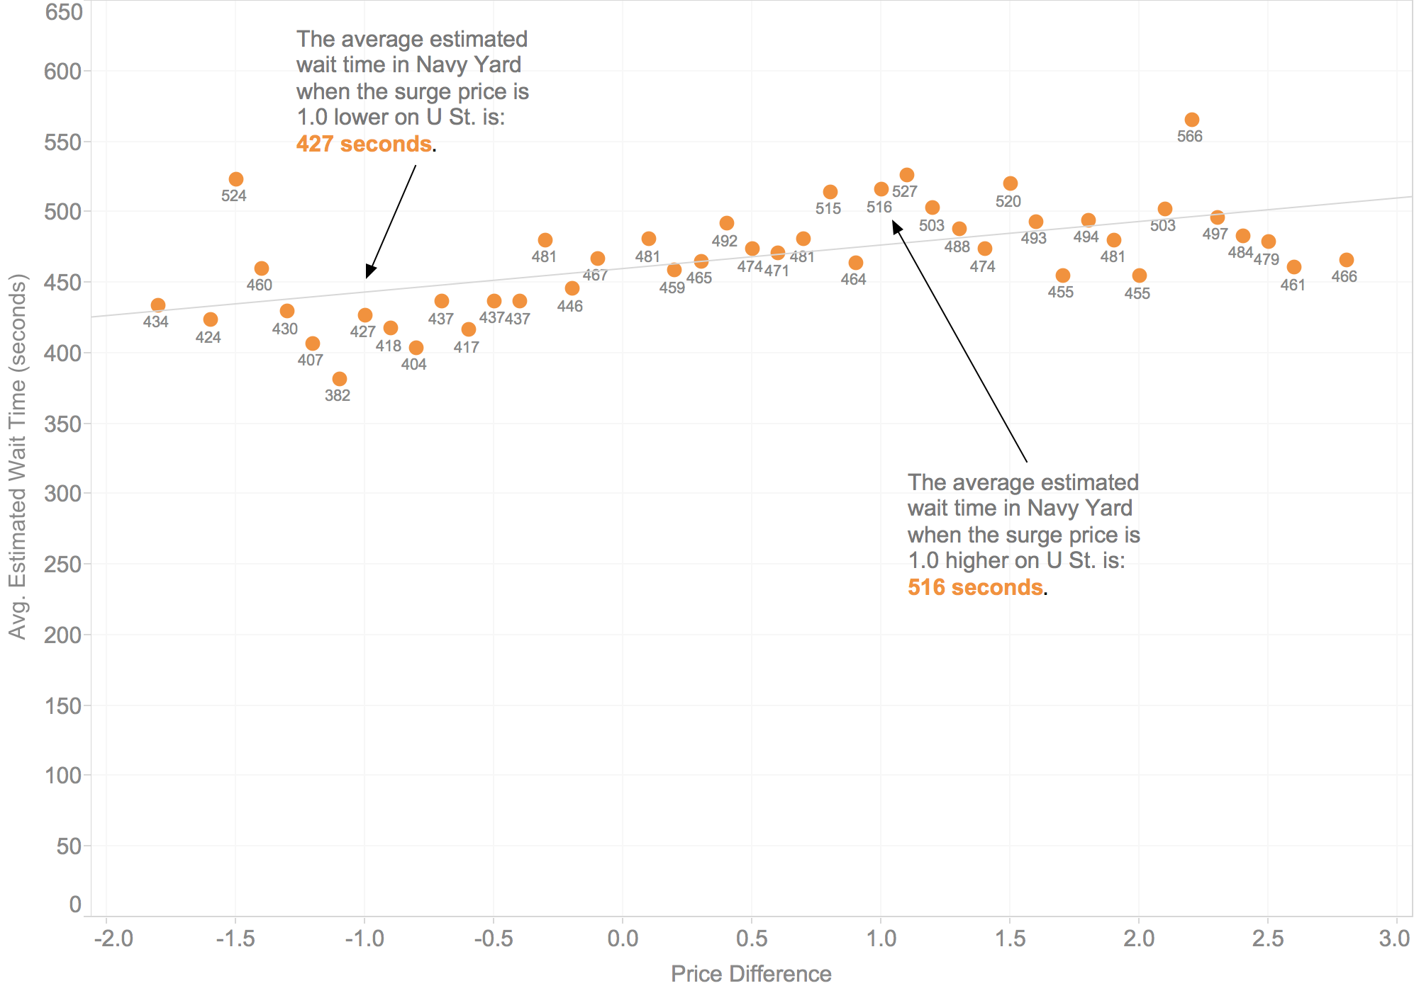
Notes:
So the pricing algorithm seems to work somewhat for reducing wait times for cars when surge pricing kicks in. But the pricing is highly localized and is changing frequently. Is it really getting more cars on the road, or is it attracting drivers already on the road toward neighborhoods with surge prices? The data in fact suggests the latter: when prices are higher in one neighborhood it saps capacity away from an adjacent neighborhood. For instance, if surge pricing is higher on U St. or K St. I found that the estimated waiting time, the service quality, suffers in the Navy Yard. As the next chart shows, if the price is 1.8x higher on U St. than in Navy Yard this means a rider in Navy Yard would have to wait on average 40 seconds longer for a pick-up.
Instead of getting more drivers on the road, Uber’s surge pricing appears to deplete drivers in adjacent areas. A price hike in one area means drivers move there, but away from another, leaving it underserved. If someone in the newly underserved area now needs a car they wait longer, or a surge price has to come into effect to get a car over there. At the end of the day the Uber system is about re-allocation of supply. And this raises interesting questions about which neighborhoods “deserve” to have higher service quality. Higher prices for some means worse service quality for others.

Slide 7
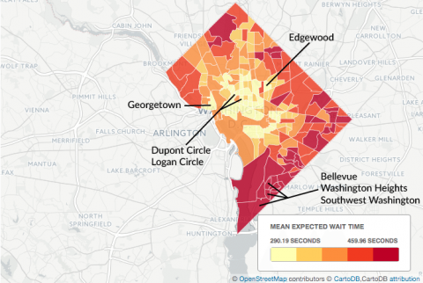
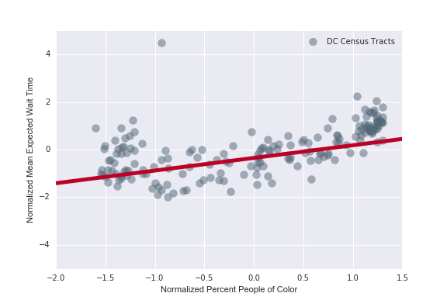
Uber Service Quality

Slide 8
IRS Audits
Fraud Detection
Political Messaging
Urban Planning
Credit Scores
AirBnb Pricing
Predictive Policing
Yelp Reviews
Copyright Infringement
Student Matching
Net Neutrality
Comment Moderation
College Rankings
Twitter Trends
Advertising
Government Censorship
Welfare Management
News Personalization
Automatically Generated Content
Teacher Rankings
Romance & Dating
Criminal Sentencing
Search Rankings & Completions
Human Resources
News Layout
Recommender Systems
Notes:
Slide with word cloud: The basic idea here is that not just in romance, but in many walks of life we’re now turning over important decisions to algorithms. Point out some of these examples and perhaps provide a sentence of context.
Why this matters for journalism is that these algorithms wield an increasing amount of power over us, but we have little clarity over how they operate and exert that power.
Interesting to mention: http://mobile.nytimes.com/2014/08/11/opinion/sentencing-by-the-numbers.html?referrer=&_r=3

Slide 9
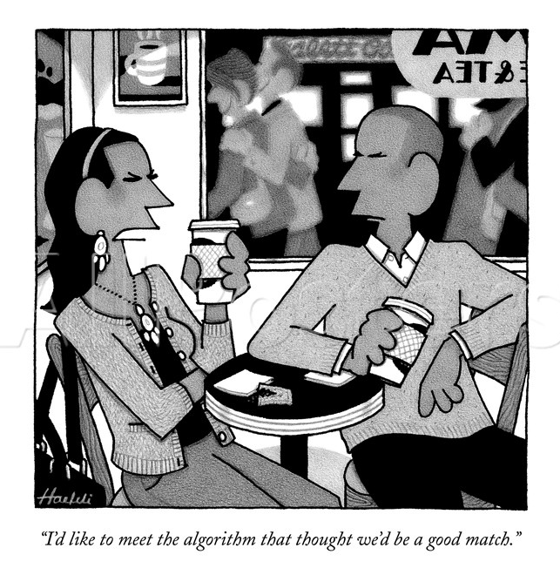
Notes:
There are even algorithms in things like romantic dating, which this clever New Yorker cartoon captures. Actually it’s quite astute, you have an annoyed woman who says: “I’d like to meet the algorithm that thought we’d be a good match.” which kind of drives at an underlying issue with algorithms which is that they’re not accountable.
We don’t really know HOW they came to their decisions: whether that be a romantic match, or a search ranking, or what have you.

Slide 10
Algorithmic Accountability
How to investigate algorithms that are use in media, government, or industry?
How can we characterize the bias, power, or influence of an algorithm?
What role might journalists play in holding algorithmic power to account?
N. Diakopoulos. Algorithmic Accountability Reporting: On the Investigation of Black Boxes. Tow Center Report, Columbia University. Feb., 2014.
Notes:
Which brings up a need to think more about algorithmic accountability: an emerging new dimension of investigative journalism that makes algorithms its focus and asks questions like …
We might employ methods like reverse engineering of an algorithm’s input-output relationship, or auditing to help characterize adapative and personalized algorithms
Now news orgs are also corporations that operate algorithms. What does it mean to have such an algo operating internally to a news org?

Slide 11
Prioritization
Classification
1
2
3
Association
Filtering
Notes:
Algorithmic Power: decisions
Where does algorithmic power come from? Algorithms derive their power through the scale of their ability to make decisions over quantified data - give a couple examples
The crux of algorithmic power is really autonomous decision-making. We might start to assess algorithmic power by thinking about the atomic decisions that algorithms make. And they can be composed and composited to arrive at higher level operations like summarization. This framework can help identify what we might focus on when investigating an algorithm, and suggests questions: criteria, errors, biases in training data, editorial criteria.
Prioritization: fire-inspections in new york. Parollee attention, net neutrality
Classification: contentID – infringing or not
Association: google auto complete
Filtering: Censorship on social media – e.g. chinese censorship or the filtering of child pornography from search results

Slide 12


Notes:
Yelp: Example of an algorithm affecting the market and business.
Nice tag line “real people, real reviews” except that the problem is that sometimes they’re not real reviews, or they are, but Yelp doesn’t think they are.
Yelp employs an automated filter that tries to categorize whether a review is legitimate or not. As in the screen cap, the filtered reviews “are not factored int the businesses overall start rating”

Slide 13

16% of reviews filtered as fake
An Imperfect Filter
De-emphasize Legitimate Reviews
Leave Fake Reviews Intact
+1
5-9% increase in revenue
Notes:
So a categorization algorithm like they use can make mistakes. It can make false positive (reviews that are legit but that are filtered out) and false negative (reviews that are fake but that are left intact). These errors can be tuned in different ways.
The essential business concern is that if the errors happen to leave more deleterious reviews intact while removing their better reviews it can affect their bottom line. Research has shown that a 1 start increase in reviews on yelp can increase business revenue by 5-9%
This has led to allegations that Yelp may be intentionally manipulating this in order to get businesses to buy advertising.

Slide 14
Input-Output of an Algorithm
Input
Output
Notes:
So now that we’re seen some of the potential impacts of algorithms in online media, civic life, and commerce, let’s talk about how we might actually go investigate and make sense of algorithmic power.
Algorithms may be black boxes, but they have two little holes in the side, one for inputting and one for outputting. And if you vary the inputs in enough different ways and pay close attention to the outputs, you can start piecing together a theory of how the algo works.

Slide 15

Algorithm Auditing
Code Audit
Requires specialized knowledge, versioning, system setup, FOIA access, data access
Noninvasive User Audit
User surveys about their experience. Non-experimental, sampling issues, self-report
Scraping Audit
Analyze input / output. EULA, CFAA issues
Sock Puppet
Impersonate users with programs. Ethics of deception
Crowdsourced Audit
Have real users report back data about platform.
Combine with software reporting.
Christian Sandvig, Kevin Hamilton, Karrie Karahalios, Cedric Langbort. Auditing Algorithms: Research Methods for Detecting Discrimination on Internet Platforms. ICA 2014.
Notes:
The code review is of limited use, b/c it takes very specialized knowledge to make sense of that. Also, it’s unlikely that illegal or otherwise deleterious algorithms would blatantly put something that was obvious in the code – it would be more obfuscated. Also issue with versioning, and having the right system setup to run the code. Issues with FOIAing code etc. And you might need access to the data they’re using as well as it may be a combination of code + data that produces a negative effect.
Want to mention examples of some of these. I’m not sure of noninvasive, but for scraping can mention my autocompletion work on google / bing, for crowdsourced can mention Message Machine

Slide 16
WSJ Price Discrimination
Do different people pay different prices depending on their geography or browser history?
Staples.com
Geo
Cookies
Prices
Jennifer Valentino-DeVries, Jeremy Singer-Vine, and Ashkan Soltani. Websites Vary Prices, Deals Based on Users’ Information. Wall Street Journal. Dec, 2012.
Notes:
At the WSJ they used reverse engineering to understand how online commerce sites like Staples dynamically set prices based on things like geography and browser history. This involved simulating thousands of surfing sessions and recording prices.
Also: rosetta stone, orbitz, home depot

Slide 17
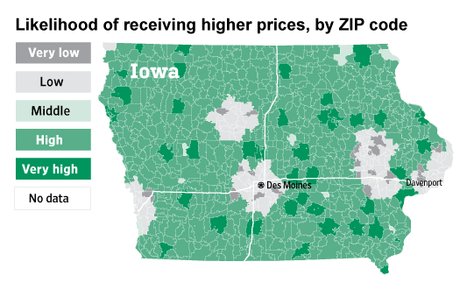
Notes:
The tendency to see discount prices appeared to be tied most strongly to distance from an OfficeMax or Office Depot — Staples' main competitors.
• ZIP Codes within about 20 miles of a competitor's store tended to see discount prices.
• ZIP Codes farther away from a rival store tended to see higher prices, even more so if the ZIP Code contained a Staples store.
• Cities (which were more likely to have Staples stores as well as competitor stores) tended to see discount prices in the Journal's tests as well.
• The Journal also examined numerous other possible factors, including income and race, and found that none were tied as strongly to price as competitor-store locations.

Slide 18
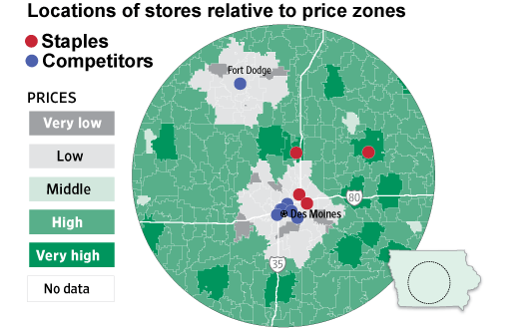
Notes:
The tendency to see discount prices appeared to be tied most strongly to distance from an OfficeMax or Office Depot — Staples' main competitors.
• ZIP Codes within about 20 miles of a competitor's store tended to see discount prices.
• ZIP Codes farther away from a rival store tended to see higher prices, even more so if the ZIP Code contained a Staples store.
• Cities (which were more likely to have Staples stores as well as competitor stores) tended to see discount prices in the Journal's tests as well.
• The Journal also examined numerous other possible factors, including income and race, and found that none were tied as strongly to price as competitor-store locations.
What they found is that statistically speaking, the strongest correlation to price involved the distance to a rival’s store from the center of a zip code. Prices tend to be higher in areas with less competition, including rural or poor areas.

Slide 19
Readings
Websites vary prices, deals based on Users’ Information
Is is fair to discriminate in terms of prices to different people based on their location? What are pros / cons?
Are there any ethical issues involved with this work?
Notes:
Driving prices down through competition could be a good thing
Location correlates with other demographic factors like income and race so you might incidentally discriminate racially
Ethics: is it ok to pose as a different user to capture price data from that location?

Slide 20
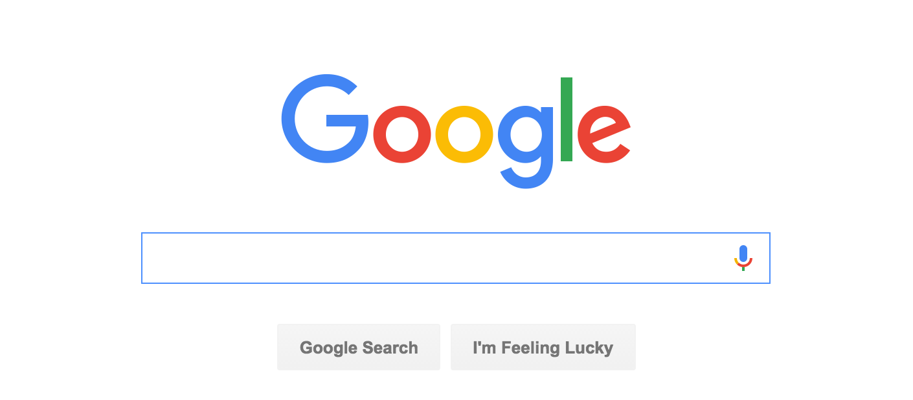
Notes:
So I talked about Facebook a bit to motivate this talk but Google is something else we all use on a daily basis … and there is a tremendous amount of power embedded in how it directs attention. Still about a third of news content is found via search, and more than half of americans get news via search.

Slide 21
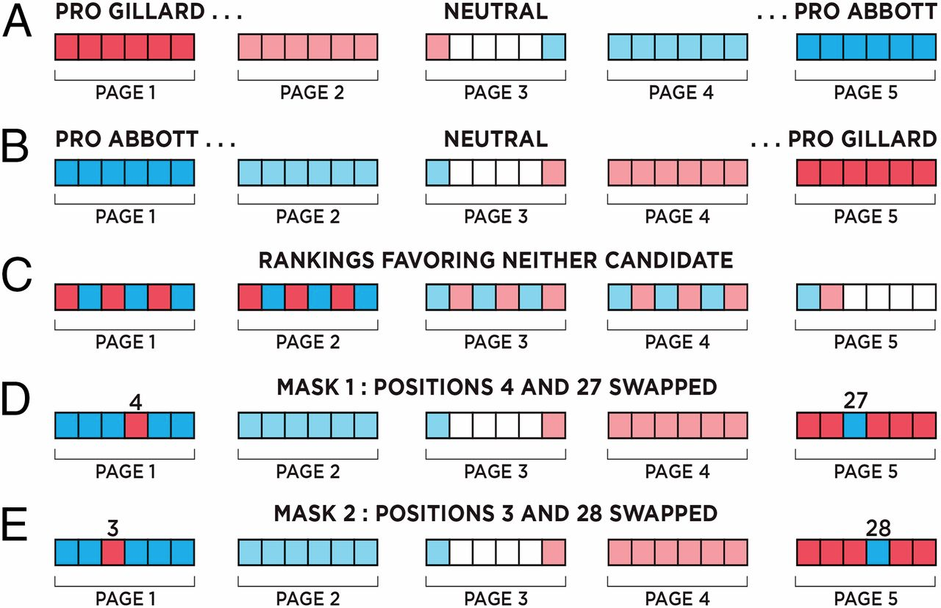
SEME – Search Engine Manipulation Effect
The search engine manipulation effect (SEME) and its possible impact on the outcomes of elections. PNAS. 2015.
Notes:
A recent study in PNAS identified what they call the search engine manipulation effect, which shows that voting preferences can be linked to biases towards one candidate or another in mock search results.
First experiment was about 2010 election in Australia.
A, B, D, and E shift voter preferences compared to control C.
D, and E serve to mask the manipulation so that people don’t recognize the bias, whereas about 25% of participants noticed the bias in A and B.

Slide 22
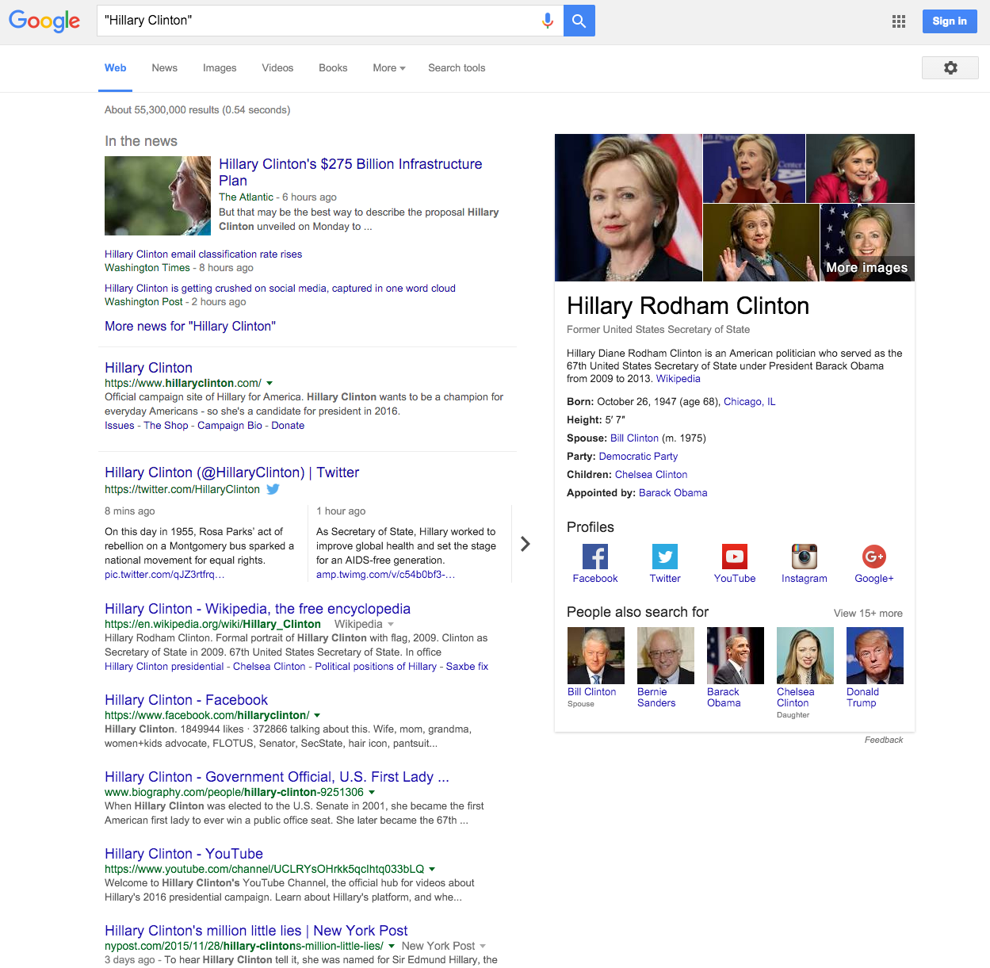
Notes:
One of the criticisms of that study is that it lacks ecological validity … it’s a faked search engine. So we’re looking at the real thing and how rankings around candidates may be biased.
Point out the official sites, and only 1 critical news article on the 1st page of hillary.
Question for accountability is how do we audit search results.
This is something we’re current exploring in terms of political topics heading into the 2016 election. We want to track bias on different politically charged topics and candidates on a periodic basis and measure the opposition / support bias of the top N results. We’re currently working on the crowdsourcing validation, and will be looking forward to implement NLP techniques to integrate early next year.

Slide 23
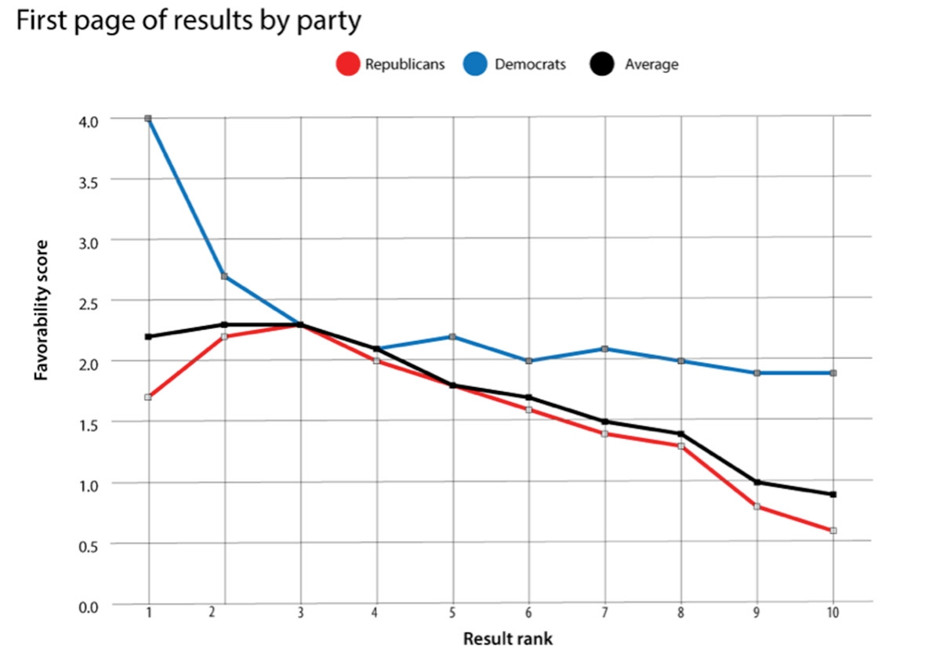
Why Google Search Results Favor Democrats. Slate. 2015.
Notes:
Methodologically: use scraping tech to gather non-personalized (but localized) results.
Mention use of crowdsourcing to measure favorability score. Process for validation against ground truth.

Slide 24
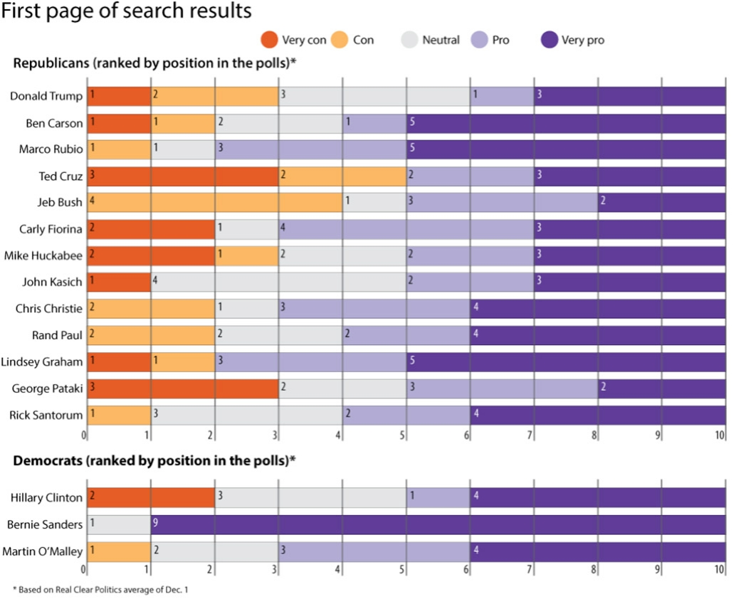

Slide 25
Auditing Challenges
Information Deficits
Lack of internal knowledge of systems challenges interpretation
Difficult to answer “Why”
Expectations
Need agreed-upon baselines to understand deviation in context
Instability
Systems are dynamic so need tracking over time
Sampling
Sampling and dimensions of variation (e.g. locality, language)
Legal and Regulatory Issues
Terms of Use; FOIA
Notes:
Need more research on this, but also just more access to data.

Slide 26
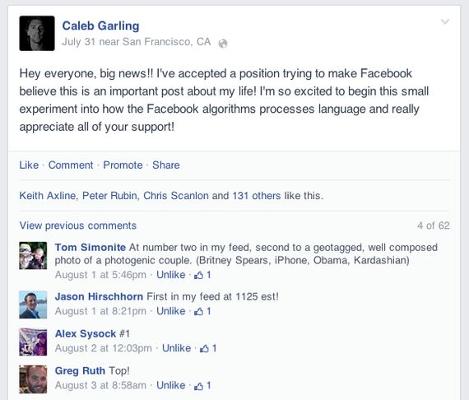
Notes:
There may be simpler alternatives to understand algorithms: you can poke and prod algos around you.
Talk about FB as a curated news feed, that some are starting to poke and explore what triggers it: http://www.theatlantic.com/technology/archive/2014/08/tricking-facebooks-algorithm/375801/ -
There was another interesting story to mention from Wired, about the writer liking everything for 2 days and the feed getting totally polluted: http://www.wired.com/2014/08/i-liked-everything-i-saw-on-facebook-for-two-days-heres-what-it-did-to-me/

Slide 27
Readings
Machine Bias
Do you think that criminal risk assessment scores should be used for bail, parole, or even sentencing? Is this better / worse than a judge?
What’s at stake using a proprietary score from a company like Northpointe?
Notes:
Issues: validity of the instruments, racial bias, opaque, difficult to challenge

Slide 28


Slide 29
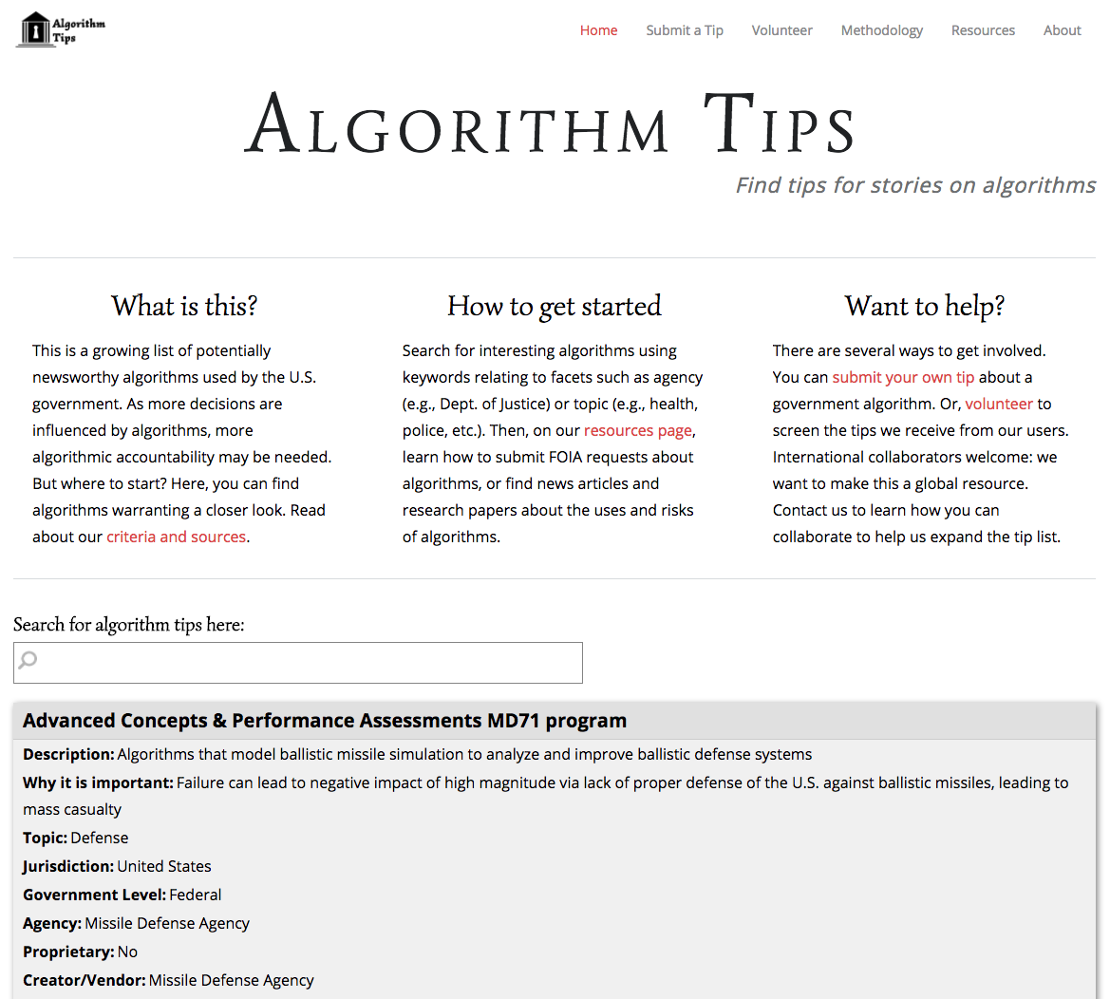

Slide 30
Accountability Investigation
Groups of three
Find an algorithm of interest to focus on from algorithmtips.org
Think about the newsworthiness of the algorithm
Why would outcome on investigation matter, and to whom? What are consequences and significance? E.g. Discriminatory / Unfair; Mistake that denies a service; Censorship; Breaks law or social norm; False Prediction; Violation of privacy
How would you investigate the algorithm?
What methodologies would you use to study it? What data might you collect to illuminate it?
Be specific and write out the analysis step by step.
Present your plan back to class.

